Slide 1
Correlation vs Radiologists

Slide 2
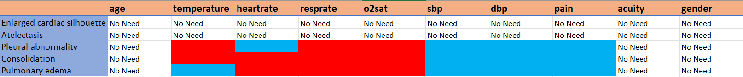
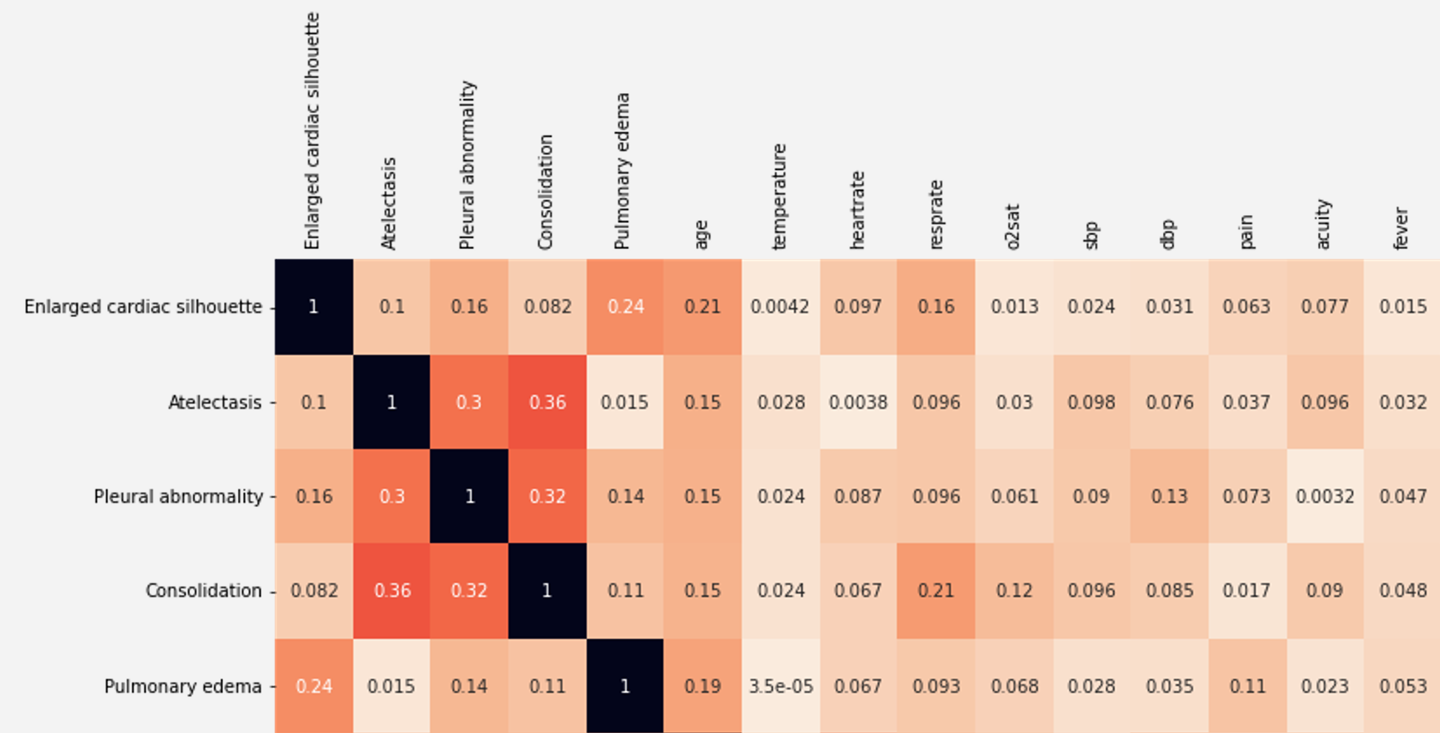
The correlation doesn’t have the right
Atalectasis is a type of consolidation that lost volume, but it has no specific clinic. It only shows loss of volume.
=> Does it mean clinical data is important for radiologists to classify Consolidation and Atelectasis? For example, if a patient has loss of volume on CXR image, do we need the clinical data to determine whether s/he got Atelectasis or Consolidation? If it’s yes, does it mean clinical data is important for Atelectasis as well?

Slide 3
MIMIC-IV v2.0

Slide 4
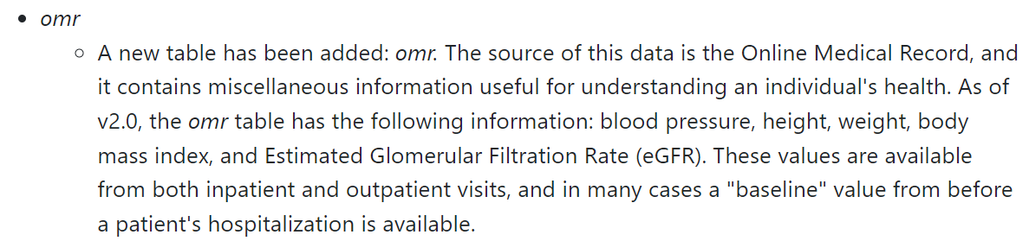
MIMIC-IV 2.0 (June 12, 2022)
A new table containing clinical data is introduced, but we don’t know if we can link them with stay_id.

